Slide 1
DATA EXTRACTION AND VISUALISATION USING VEGALITE
Presented by: Meenakshi Kanungo
B.Sc. Economics, Semester-III
Loreto College

Slide 2
INTRODUCTION
This project focuses on extracting data from Power BI report file using Dax Studio and presenting it through clear, interactive visualisations using Vegalite. The goal of this project is to combine the data processing strength of Power BI with the flexibility of Vegalite to present meaningful and interactive visual insights.

Slide 3
DATA CLEANING AND EXTRACTION PROCESS
Data Cleaning
Power BI to Dax Studio
Extracting Insights
Visualising Insights

Slide 4
DAX QUERIES
EVALUATE TOPN(10,SELECTCOLUMNS(Table1,"App",Table1[App],"Reviews",
Table1[Reviews]), [Reviews], DESC)
EVALUATE SUMMARIZE(Table1,Table1[Category], "Total Installs", SUM(Table1[Installs])) ORDER BY [Total Installs] DESC
Category | Total Installs
GAME | 13352924415
COMMUNICATION | 11038276251
TOOLS | 8001171915
PRODUCTIVITY | 5793091369
SOCIAL | 5487867902
FAMILY | 4923431405
PHOTOGRAPHY | 4648997655
VIDEO_PLAYERS | 3927002720
TRAVEL_AND_LOCAL | 2894887146
NEWS_AND_MAGAZINES | 2369217760
ENTERTAINMENT | 2113660000
BOOKS_AND_REFERENCE | 1665969576
PERSONALIZATION | 1531494682
SHOPPING | 1400348785
HEALTH_AND_FITNESS | 1143522512
SPORTS | 1096474498
BUSINESS | 697163865
LIFESTYLE | 503723539
MAPS_AND_NAVIGATION | 503281890
App | Reviews
Clash Royale | 23125280
YouTube | 25655305
Security Master | 24900999
Clean Master | 42916526
Messenger | 56642847
Instagram | 66577313
Subway Surfers | 27722264
Clash of Clans | 44881447
Facebook | 78158306
WhatsApp Messenger | 69119316

Slide 5
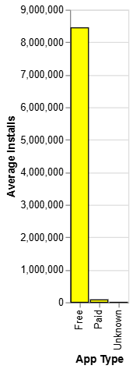
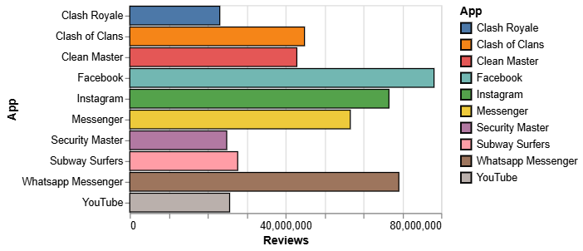
VEGALITE CHARTS VISUALISATIONS
#Top 10 apps by number of reviews
data = pd.DataFrame(
{'App': ['Clash Royale', 'YouTube', 'Security Master', 'Clean Master', 'Messenger','Instagram','Subway Surfers','Clash of Clans','Facebook','Whatsapp Messenger'],
'Reviews':[23125280,25655305,24900999,42916526,56642847,66577313,27722264,44881447,78158306,69119316]})
alt.Chart(data).mark_bar(stroke='black',strokeWidth=1,).encode(color=alt.Color(field="App"),
x='Reviews',
y='App',
)
#Average installs for each app type
data = pd.DataFrame({'App Type': ['Free', 'Paid', 'Unknown'],
'Average Installs': [8443394,76331.71,0]})
alt.Chart(data).mark_bar(color='yellow',stroke='black').encode(
x='App Type',
y='Average Installs',
)

Slide 6
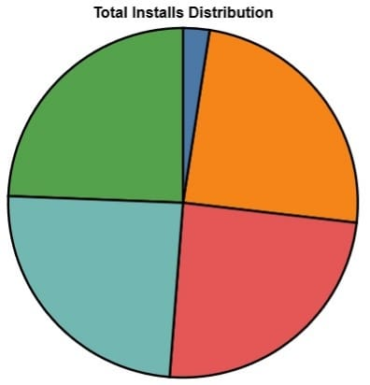
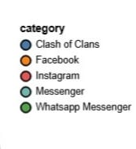
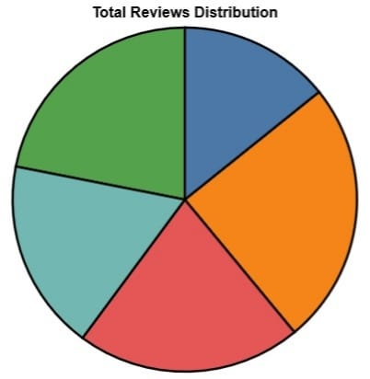
data = [
{"category": "Facebook", "group": "Total Installs", "value": 1000000000},
{"category": "Facebook", "group": "Total Reviews", "value": 78158306},
{"category": "Whatsapp Messenger", "group": "Total Installs", "value": 1000000000},
{"category": "Whatsapp Messenger", "group": "Total Reviews", "value": 69119316},
{"category": "Instagram", "group": "Total Installs", "value": 1000000000},
{"category": "Instagram", "group": "Total Reviews", "value": 66577313},
{"category": "Messenger", "group": "Total Installs", "value": 1000000000},
{"category": "Messenger", "group": "Total Reviews", "value": 56642847},
{"category": "Clash of Clans", "group": "Total Installs", "value": 100000000},
{"category": "Clash of Clans", "group": "Total Reviews", "value": 44881447}
]
df = pd.DataFrame(data)
# Pie chart for Total Installs
install_chart = alt.Chart(df[df['group'] == 'Total Installs']).mark_arc(stroke='black',strokeWidth=2).encode(
theta=alt.Theta(field="value", type="quantitative"),
color=alt.Color(field="category", type="nominal"),
tooltip=['category', 'value']
).properties(
title="Total Installs Distribution"
)
# Pie chart for Total Reviews
review_chart = alt.Chart(df[df['group'] == 'Total Reviews']).mark_arc(stroke='black',strokeWidth=2).encode(
theta=alt.Theta(field="value", type="quantitative"),
color=alt.Color(field="category", type="nominal"),
tooltip=['category', 'value']
).properties(
title="Total Reviews Distribution"
)
# Display side-by-side
install_chart | review_chart

Slide 7
KEY LEARNINGS FROM THE PROJECT
Working with Complex File Structures
Data Cleaning and Preparation
Querying with DAX
Data Visualisation Principles

Slide 8
REFERENCES
https://docs.streamlit.io/develop/api-reference/charts/st.vega_lite_chart
https://altair-viz.github.io/user_guide/data.html
https://vega.github.io/vega-lite/examples/#repeat--concatenation
https://docs.streamlit.io/develop/api-reference/charts/st.vega_lite_chart
https://www.kaggle.com/code/faisaljanjua0555/eda-google-play-store-apps/input

Slide 9
THANK YOU!

